Slide 1
HE policy making for a strong infrastructure, some reflections from HEFCE
Cliff Hancock
International Relationships Manager
5 June 2014

Slide 2
Mission and role of HEFCE
HEFCE promotes and funds high quality, cost-effective teaching and research, meeting the diverse needs of students, the economy and society.
allocating public funds for teaching and research
promoting high-quality education and research
promoting links between HE and industry/commerce
encouraging diversity and equal opportunities
advising Government on the future needs of the HE sector
ensuring accountability and value for money.

Slide 3
HEFCE people
15 Board members – responsible for strategic planning. Appointed by Secretary of State for BIS – but not accountable to him.
Chief Executive appointed by the Board
Mixture of heads of HEIs, and people from industry/commerce. Details on the HEFCE website: www.hefce.ac.uk
Policies are developed and put into practice by around 250 staff, most work at Northavon House in Bristol.

Slide 4
Fundamental principles
In the UK, universities are autonomous – make their own strategic plans, hire and fire staff, select students, responsible for their own governance, academic standards, free to generate income …
HEFCE is at “arm’s length” from both the government and the sector (an intermediary or buffer body) – not unique in world HE but not many others An observation: Governments have a ‘life’ of 5 years (max.), HEFCE can trace its history back to 1919 (UGC), Universities have been around for centuries.
Notes:
Oxford and Cambridge 12th century.

Slide 5
Some key features of UK higher education
The UK carries out almost 8% of world research and produces over 14% of the most highly cited papers
International student numbers and fee income have grown rapidly in the past 20 years: £400M to £2,600M
UK universities figure prominently in the various university ranking tables published across the world, e.g. 2 in the top 10, 11 in the top 100 of the SJTU rankings 2010 and 2011 – but 2 in top 10 and 9 in top 100 in 2012 and 2013.

Slide 6
Excellence and diversity in learning and teaching
Assuring and enhancing quality
Protecting and promoting the interests of students
Supporting student opportunity and social mobility
Providing information about HE for prospective students and others
Supporting the strategic use of learning technologies
HEFCE investing on behalf of students and in the public interest.

Slide 7
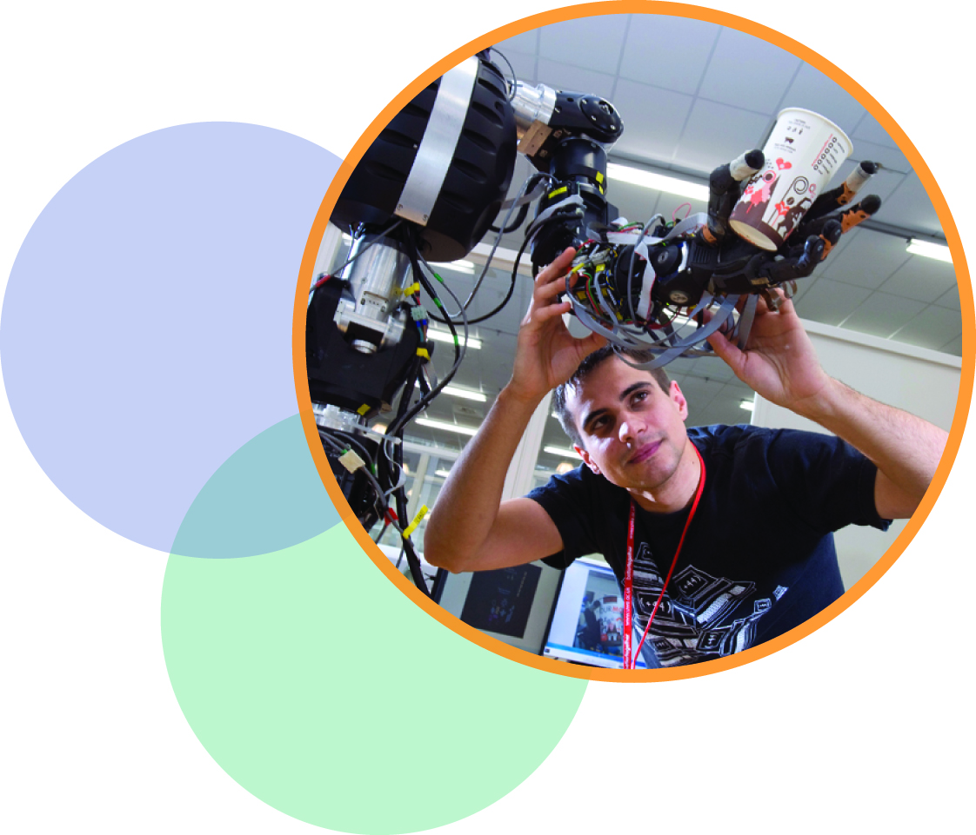
World-leading research
Strength of dual-support system
Sustaining public investment to maintain strength and dynamism of UK research base
Rigorous assessment of research through the REF
Investment in people and infrastructure; vibrant postgraduate and postdoctoral communities.

Slide 8
How the West views Libya today
Libya faces a long road ahead in liberalizing its primarily socialist economy, but the revolution has unleashed previously restrained entrepreneurial activity and increased the potential for the evolution of a more market-based economy.
Source: CIA website – accessed 3 June 2014
Notes:
Oxford and Cambridge 12th century.

Slide 9
Strengths of the English HE system that may be useful for Libya
True institutional autonomy
Monitoring proportional to risk
Appropriate Governance arrangements
Leadership development
Management training
Quality assurance/assessment arrangements robustly defined and impartially administered (both for teaching and research)
Intermediary/buffer body
Notes:
Oxford and Cambridge 12th century.

Slide 10
Aspects of the English HE system that may not be useful for Libya
Plethora of agencies – Quangos and others (HEFCE et al, SLC, OFFA, OIA, QAA, HEA, LFHE, UKTI, RCs, UCAS, HESA, UUK, GuildHE, Mission groups, HEPI, …)
Complementarity vs collaboration vs competition
Tools used out of context (e.g. REF)
Research/teaching divide vis a vis career development
HE as ‘political football’
‘Helicoptering’ in ‘experts’ and ‘solutions’
Intermediary/buffer body
Notes:
Oxford and Cambridge 12th century.

Slide 11
Thank you for listening
c.hancock@hefce.ac.uk

